Slide 1

INVESTOR PRESENTATION Q3 FY19
25-01-2019 | © Mphasis 2018 Proprietary and confidential information

Slide 2




Enable Customers to reimagine their Digital Future by shifting anything to Cloud and power everything with Cognitive
Customer First
Front2BackTM Modernization
Anything to Cloud
Cognitive Everything

Slide 3
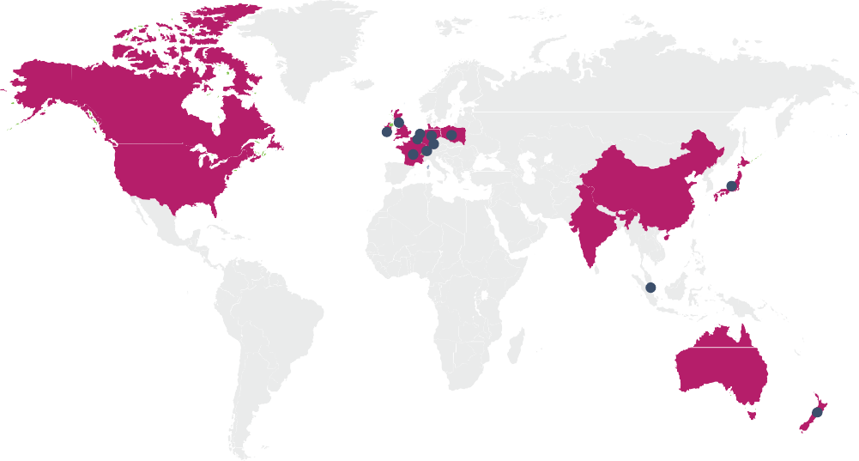














Mphasis at a Glance
Key Facts
Global Delivery Footprint and Sales Coverage
Incorporated in 1992
Marquee clients including largest bank and insurance companies in North America, largest publicly traded Invest. Services firm, largest logistics provider and largest commercial RE player
52.3% owned by Blackstone*, a Global Private Equity firm
Headcount of 24,215*
UK
Netherlands
Poland
Germany Switzerland
Canada
USA
Ireland Belgium France
China
Japan
Financial Strength
India
Singapore
Market Cap *
Revenue ^
Cash *
$2.82 billion
$1,091 million
$262 million
Australia
New Zealand
Geographical Split of Revenue #
Deep domain expertise in BFSI #
67% of Revenue from Direct International #
4%
Direct Others
India & RoW revenue primarily from European and American Strategic Customers with billing entities abroad.
27%
56%
78%
DXC/HP Channel
29%
44%
5%
6%
11%
Direct Core 55%
17%
Product Portfolio
Americas
* As of 31st Dec 2018
12%
4%
Direct International
67%
EMEA India RoW
# Quarter ended 31st Dec 2018
BCM
Insurance
ITCE
Emerging
^ trailing 12 months
Digital Risk
8%

Slide 4
Mphasis Turn Around Story
290
280
270
260
250
240
230
220
210
283.2
+3.6%
264.1
275.6
268.7
259.7
256.0
249.8
-1.3%
251.6
239.5
242.3
234.5
237.0
228.2
229.0
230.9
226.5
225.3
224.5
224.1
223.5
221.5
Q4 Q1 Q1 Q2 Q3 Q4 Q1 Q2 Q3 Q4 Q1 Q2 Q3 Q4 Q1 Q2 Q3 Q4 Q1 Q2 Q3
’13 ’14* ’15 ’15 ’15 ’15 ’16 ’16 ’16 ’16 ’17 ’17 ’17 ’17 ’18 ’18 ’18 ’18 ’19 ’19 ’19
Company Revenue in USD $M (gross)
* Transition Year 5 months adj.

Slide 5








Performance Highlights
Performance vs Index¹
Consistent track record of growth³
Total Returns to Shareholders in last 12 months (%)²
283.2
275.6
+42.8%
268.7
+23.8%
+3.2%
264.1
Q4’18
Q1’19
Q2’19
Q3’19
YoY %
+19.2%
+16.4%
+13.7%
+12.3%
Nifty - IT
Nifty
Mphasis
Indexed to 100 - As of 12/29/2017
Includes Dividend and Share splits; As of 12/31/2018
3. Overall Gross revenue – $ Mn

Slide 6





Corporate Strategy : Bring the “T” back into IT
‘Inverted T’
GTM Plays
Customer Segments
Vertical Play
Front 2 Back
Transformation (F2B)
1. Strategic Customers
Wealth Management
Health Insurance
Emerging Verticals…
Service Transformation
(ST)
Retail Banking
Insurance
2. HP/DXC Technology
Focus Geographies:
Americas
Europe
Cloud Services
3. Blackstone Portfolio
Powered by
Cloud & Cognitive
4. New Client Acquisition
Horizontal Play
Cloud Cognitive
Digital CX Traditional
Traditional Services
Global Account Delivery Leadership Onsite to engage with Clients

Slide 7
Core Investment Thesis
1▪ Accelerate Direct Core - Continue to outgrow the market with a three pronged approach –
Farming Strategic Accounts
Blackstone Portfolio Opportunity
Focused Strategy for New Logos
2▪
Strategic Partnership with DXC/HP – Transformed relationship with four growth engines
3▪
Continued focus on Margin Expansion to fuel Growth
4▪
Strong Management team backed by an experienced Board
5▪ Strong Cash-flow Generation and Optimal Cash Strategy to maximize shareholder value

Slide 8
Accelerate Direct Core : Track record of Growth driven by New Generation Services
1
Strong Direct Core Revenues Supported by significant wins in NewGen
Overall CAGR
+11.1%
34,732
484
+13%
32,156
435
105
28,795
78
24,143
Traditional
379
358
Traditional
New-Gen CAGR
+44%
New-Gen
New-Gen
FY15
FY16
FY17
FY18
YTD FY18
YTD FY19
% New-Gen
19%
29%
32%
40%
New TCV won ($ Mn)
New-Generation Services contributed to 83% of total deal wins (TCV) in FY18 and 40% of Revenues in FY18
New-Generation Services contributed 45.6% of Direct Core revenues in YTD FY19 representing a YoY growth of 51%
Note: Direct Core constituted 78% of Direct International Revenue (and 55% of Mphasis Revenue) in FY18

Slide 9









Accelerate Direct Core : The Secret Sauce Fueling the Engine
1
Domain Strength built by… … years of working with Marquee Customers
Strategic Accounts: Relationship Tenure 11/16 strategic clients are from BFSI verticals
Non-BFSI
Verticals
Consumer Banking &
10
Customer base include many industry leaders:
20%
Mortgage
Select chosen sub- verticals within the BFSI sector
Invested in domain
experts with deep
27%
Largest Bank in North America
Largest Insurance Company in North America
Largest publicly traded Invest. Services Firm
Largest Logistics Provider
Largest Commercial RE player
5
17% Wealth
Management
1
Other BFSI
25%
10%
industry expertise
Well entrenched across multiple business lines
at customers
P&C Insurance
in chosen areas
0-5 yrs
5-10 yrs
10+ yrs
Go-to-Market optimized for catching Deals Upstream
Proactive Customer Management
Institutionalized Early Engagement sales process
Robust account planning for selecting early engagement areas based on spend, competition and ability to win
Onsite Global Delivery Account Leader (GDAL) works proactively with the customer to address issues in real time
Service Delivery Excellence and CSAT focus
38%
19%
Traditional New Gen
Account | Ranking
Large North American Bank | # 1
Leading Investment Services Firm | # 1
Global Logistics Co. | # 1
62%
81%
FY17 FY18
Majority of proactive wins are in New-Gen areas

Slide 10
Accelerate Direct Core : Focused Strategy for New Logo Wins
1
Consumer Banking
Wealth Management and Brokerage
Property and Casualty Insurance
Governance, Risk and Compliance
Identified Targets in select BFSI Micro-verticals
Investment Banking
Mortgage Banking
Life Insurance
Cards & Payments
Cloud
Digital Technology Services
Cognitive
Horizontal Capabilities with a focus on Cloud and Cognitive
Automation Led Ops Transformation
Classic AMS Transformation
Next Generation Infrastructure
Focus on select Geographies
USA
UK
Europe

Slide 11


Cognitive Computing
1
Accelerate Direct Core : Mphasis X2C2 TM - Cloud and Cognitive
Cloud Services
Cloud CoE – Investing in building IP / Accelerators
End to end Services - incl Cloud Consulting, Cloud Migration (re-host, re-factor, re-purchase), Cloud Native App Dev, DevOps, Cloud Ops
Strong Cloud Partnership Network – Pivotal
Setting up a Pivotal Lab to build skillset for next generation cloud services
Case Study 1 - One of the Largest Brokerage Firms
Application development and migration using Pivotal Cloud Foundry; development of leading Robo Advisor
Case Study 2 - Largest Retail Banks in the US
Successfully transitioned middleware into micro services,
enabling a faster front end at a lower cost
Case Study 3 - A Step towards Zero UI
Digital Partner of Choice of 5 Fortune 500 Companies
One of the first applications on Apple Pay
First to introduce Semantic technology to a Large NA bank
Pioneer of integrating Natural Language Interaction with
Salesforce.com
Next Angles – AI and NLP based GRC Automation platform
Deep Insights - Cognitive computing platform, which transforms enterprise decision by depth analysis of structured and unstructured data sources
Infragenie - Intelligent infrastructure automation platform that predicts, diagnoses and resolves infrastructure issues
Hypergraph - Actionable insights by bridging the gap between
enterprise data and external data
Set up NextLabs

Slide 12





Accelerate Direct Core : Mphasis X2C2 TM - Front to Back Transformation
1
Engagement Layer
Intelligence Layer
Core Systems
UX
Cognitive
Social
Data &
Analytics
Microservices
Core Systems
Appification
Business & Policy
Knowledge
Any Device
and APIs
Customers / Stakeholders KPI Driven
Process & Enterprise
Context
NLP
UI
Sentiment
2
Mphasis X2C _{TM} - Powered by Cloud & Cognitive
Right sized transformations delivering chunks of business value in a timely manner
Best way to introduce disruptive technology (X2C²) to legacy environments
Reference architecture based transformation: leverages technology from previous iterations to reduce marginal cost of implementation
Traditional
F2B
Y1
Y2 Y3 Y4
Q1 Q2 Q3. Q4

Slide 13

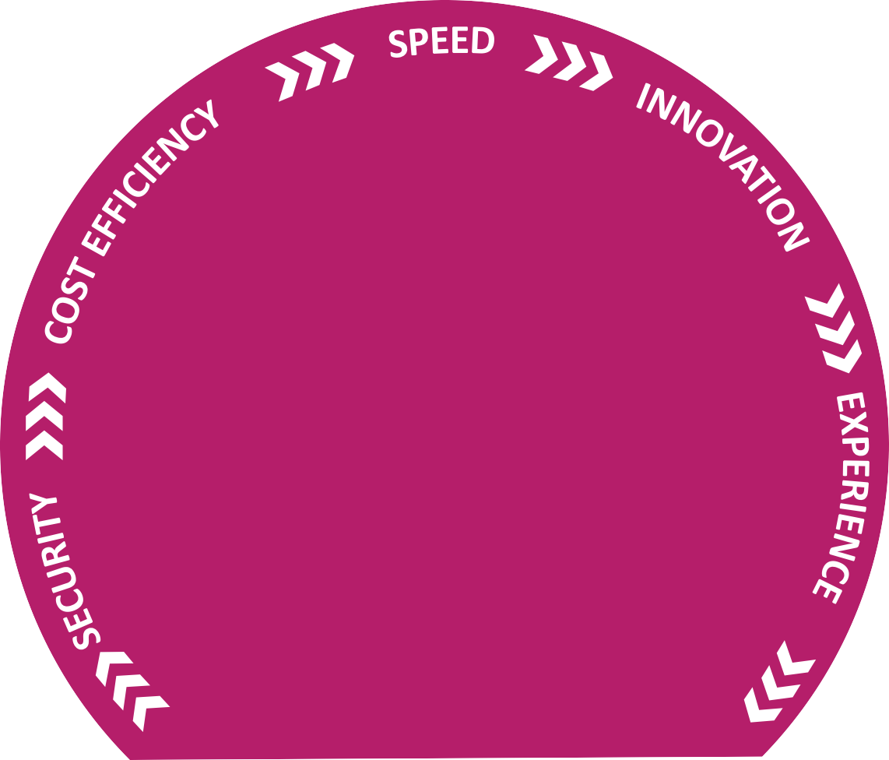




Accelerate Direct Core : Mphasis X2C2 TM - Key Levers and Benefits
1
Holistic 5D approach Integrated Mphasis X2C^{2 TM} Benefits
CLOUD
NATIVE
› DevOps & Agile Enablement
› Pivotal Based App
Development
Business Value
Mphasis X2C² _{TM}
CLOUD MIGRATION
› Automated Migration
COGNITIVE APPLICATIONS
› Design Thinking
› Smart Applications
› Deep Learning & Advanced Analytics
› Decision Modeling
Traditional transformation methods
FRONT₂
› Data Center Migration
› Portfolio
Transformation
› Cloud Ops
Transformation Scope
BACK
TRANSFORM
Cloud Migration Reference Architecture | Cloud & Cognitive Lab Transformation Scope | Pre Integrated Cognitive Platform
CX Analytics Framework | Advanced Level Partnerships | Design Thinking Methodology
DevOps Analyzer | Customer 360 Platform | Large Implementation Experience
Cognitive Capability as a Service Architecture | Encoded Domain Knowledge Models | Smart App Framework
COGNITIVE
AUTOMATION
› Robotic Process
Automation
› Ops IT Automation
CLOUD INTEGRATION
› Secure iPaaS Implementation
› Cloud integration Gateway

Slide 14

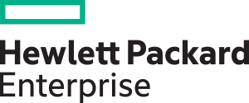




² Strategic Partnership with DXC/HP: Transformed Relationship with four Growth Engines
A series of corporate actions have resulted in
creation of four new entities -
Hewlett-Packard Company
Oct 2014 (Nov 2015)
Mar 2016
(Apr 2017)
Sep 2016 (Q3 2017)
Enterprise
Services Business
Enterprise Group
and Core Software
Non- Core
Software Assets
HP Inc.
$58 bn
Revenue:
$25 bn
$31 bn
$3.2 bn
Mphasis DXC/HP Channel Revenue Contribution:
88% 8%
4%
Mphasis is a preferred supplier to each of these four entities

Slide 15

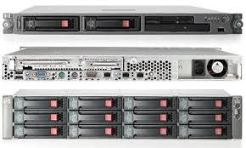
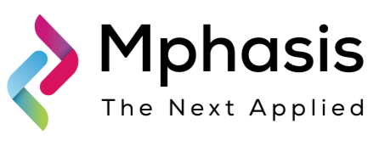
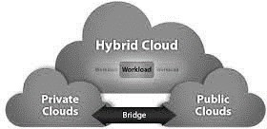
Strategic Partnership with DXC/HP: Apps Migration to Cloud
2
May 25th 2017: DXC Technology (NYSE: DXC) has named Mphasis as a new Solution Partner to transform and modernize enterprise applications for public, private and hybrid cloud.
Focus Verticals
Focus Geographies
Offerings
Banking and Financial Services
Insurance
North America
UK
Front2BackTM Modernization
Applications to Cloud
Cloud Native Apps
Client Benefits
Faster Transformations: Rapidly capture untapped value of the cloud for mission critical and high value applications
Lower Costs: Offer lower cost consumption-based models and automation to reduce the cost of legacy IT
Right Skills: Access to the next generation of IT skills and innovative capabilities
Why Mphasis and DXC?
Joint GTM track record: 10 year relationship with the Enterprise Services business marked by successful joint wins in the market.
Impeccable Delivery: Mphasis has a NPS of 85
Next Gen Offerings:
X2C^{2 TM}, iADMS™, Front2Back™ Modernization

Slide 16
Action plan to drive Margin Expansion to fuel Growth
3
Concrete steps executed...
…delivering a track record of Margin Expansion¹
Divestment of Domestic BPO business
Stabilization and offshoring to improve margins for Digital Risk
Margin expansion through Improvements in various operating levers
Operating Margin
(EBIT %)
13.3% 12.8%
16.3%
14.6%
15.1%
Consistent improvement in Operating Margin profile
Restructured people supply chain
Increased pricing power
Business model shift
FY15 FY16
“Digital Factory of the Future” – ensure stable margins while funding growth …
FY17
FY18
YTD FY19
Establish best-in-class scalable delivery and operations by installing and operationalizing key medium-long term enablers (people supply chain)
Focus on structural savings – inefficiencies taken out stay out; implementation support and Results Delivery Office
Key Levers:
Pyramid Optimization
Commercial Model
Automation
Strategic Shoring
People Supply Chain
Tail Account Rationalization
Margin improvements and cost savings at each level, along with an increasing trend of non-linear revenues
(1) FY15 based on Indian GAAP; FY16 based on special purpose Ind-AS, FY17 & FY18 are based on Ind-AS

Slide 17
Strong Management
4
1 •
Infused new talent across levels
Executive Committee
Senior Leader positions
Regional Sr Leaders in Focus Markets Strong Board
2 ▪
3 ▪ Support from BX Ecosystem

Slide 18
Strong Cash flow Generation and Optimal Cash Strategy to maximize shareholder value
5
Strong growth in EPS
EPS after exceptional items (INR)
Track record of healthy Dividends…
Dividend Payout (DPS including tax / EPS before exceptional items)
70%
37.7
42.7
41.8
32.1
60%
56%
30.1
53%
FY15
YoY %
FY16
FY17
FY18
FY15 FY16 FY17
Completed share buy-back worth Rs 9,937 Mn in Q3 FY19
Completed share buy-back worth Rs 11,030 Mn in FY18
FY18
YTD FY19
37.1%
-6.3% 25.3%
13.5%
Consistent free cash flow generation
Free cash flow ($ million)
One of Industry leading FCF/EBITDA conversion
Free cash flow (FCF)/Adj. EBITDA
115
131
121
112 109
68%
72%
70%
59%
FY15
FY16
FY17
FY18
YTD FY19
FY15 FY16 FY17 FY18
FCF/Adj. EBITDA ratio of FY’17 lower due to advancement of salary payment dates in Q4’17

Slide 19
Core Investment Thesis: Execution update Summary – YTD FY19
1▪ Accelerate Direct Core
Strong growth of 15.0% YoY in Constant Currency
Continued momentum in Deal wins: $484M TCV; New-Gen Services at 78%
Broad based growth from Strategic Accounts; BX portfolio and New Accounts
Farming Strategic Accounts
Blackstone Portfolio Opportunity
2▪ Strategic Partnership with DXC/HP
Continued Strong growth momentum from FY’18; YoY constant currency growth of 25.5%
Good deal traction in Cloud Partnership; Won significant transformation deals
₃▪ Continued focus on Margin Expansion to fuel Growth
Delivered EBIT of 16.3% in YTD FY19; Continued improvement in operating levers
Expect to operate in EBIT of 15%-17% band
Strong Management team backed by an
experienced Board
Management augmenting Cloud and Cognitive capabilities to deliver Service
Transformation and Front-2-Back Modernization
4
₅▪ Strong Cashflow Generation and Optimal Cash Strategy to maximize shareholder value
Strong free cash flow generation of $121 Mn in YTD FY19; Q3 FY19 Cash Balance of $262 Mn (after share buyback and acquisition of Stelligent Systems LLC)
Completed buy-back of 7.3 million shares for a total outlay of INR 9,937 Mn

Slide 20

Why Are We Different?
T W I T C H
T-Shaped Solution Strategy – Domain depth + Breadth of Tech - 2C powered
Tier 1 capabilities in BFSI
Front2BackTM Modernization
X2C^{2TM}
Focus & Specialization
Data Center of the Future is an Empty
RoomTM
N=1 Hyper personalization using HyperCloud
Consistently Rated #1 or #2 by Customers

Slide 21
THANK YOU
Email: Investor.Relations@mphasis.com
About Mphasis
Mphasis (BSE: 526299; NSE: MPHASIS) enables customers to reimagine their digital future by applying a unique formula of integrated cloud and cognitive technology. Mphasis X2C² _{TM} formula for success, (shift anything to cloud and power everything with cognitive), drives five dimensions of business value with an integrated consumer-centric Front to Back Digital Transformation, enabling Business Operations and Technology Transformation. Mphasis applies advancements in cognitive and cloud to traditional application and infrastructure services to bring much needed efficiency and cost effectiveness. Mphasis’ core reference architectures and tools, combined with domain expertise and hyper specialization are the foundation for building strong relationships with marquee customers.
Important Confidentiality Notice
This document is the property of, and is proprietary to Mphasis, and identified as “Confidential”. Those parties to whom it is distributed shall exercise the same degree of custody and care afforded their own such information. It is not to be disclosed, in whole or in part to any third parties, without the express written authorization of Mphasis. It is not to be duplicated or used, in whole or in part, for any purpose other than the evaluation of, and response to, Mphasis’ proposal or bid, or the performance and execution of a contract awarded to Mphasis. This document will be returned to Mphasis upon request.

Slide 22
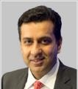
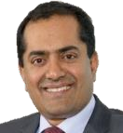
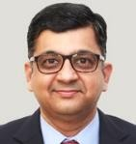
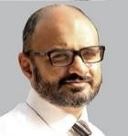
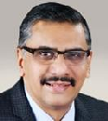
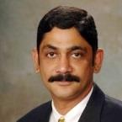
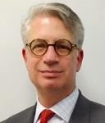
Strong Leadership Team
Nitin Rakesh CEO
Dinesh Venugopal
10 yrs in Mphasis and in ExCo
Sundar Subramanian
Joined in October 2017
Elango R
12 yrs in Mphasis and in ExCo
President, Mphasis Digital & Direct Core GTM
President, Global Delivery
President, HP Business Unit
Suryanarayanan ^{9 yrs in Mphasis}
4 yrs in ExCo
Chief Financial Officer
Joined in October
Eric Winston ₂₀₁₇
EVP, General Counsel and
Chief Ethics & Compliance Officer
Srikanth Karra
Joined in May 2017
Chief Human Resource Officer

Slide 23
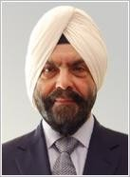
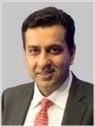
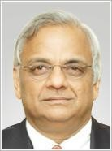


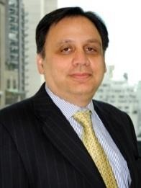
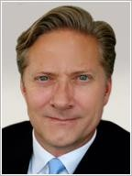
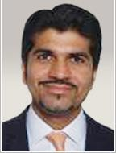
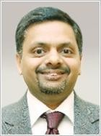
Experienced Board
 | Davinder Singh Brar Chairman, Independent Director
 | Promoter of GVK Biosciences Formerly Director of the Reserve Bank of India (RBI)
 | Nitin Rakesh CEO and Director
 | CEO and Director at Mphasis Previously CEO and President of Syntel
 | N Kumar Independent Director
 | Vice Chairman of the Sanmar Group, a multinational conglomerate Honorary Consul General of Greece in Chennai
 | Jan Kathleen Hier Independent Director
 | Formerly Executive VP at Charles Schwab Served as VP Engineering at Transaction Technology, a Citicorp subsidiary
 | David Lawrence Johnson Director
 | Senior Advisor at Blackstone based in New York Formerly Senior VP of Strategy at Dell
 | Marshall Lux Director
 | Financial Services consultant and practitioner for over 30 years On the board/ advisory council of various PEs across industries and geographies
 | Paul James Upchurch Director
 | Executive Director at Blackstone Formerly an Executive VP at Nielsen
 | Amit Dixit Director
 | Senior Managing Director and Head of Private Equity in India for Blackstone Formerly a Principal at Warburg Pincus
 | Amit Dalmia Director
 | Managing Director in the Private Equity group in India for Blackstone Formerly served various management roles at Hindustan Unilever India
Blackstone
Independent Directors

